Slide 1
Study Strategies that Really Work
Melissa Norton, Director
Learning & Accessibility Services (LAS)
12.3.25

Slide 2
AGENDA
Key Questions
Studying Musts
Strategies that Work
Exam Day
Game plan
Notes:
Preface that we are 13 days away from the first day of finals. Questions we got in advance:
- Sometimes I never know where to start when beginning to study, and I get overwhelmed very easily
Knowing when you’ve studied enough
How to focus while trying to study
Note taking optimized for optimizing studying
What is the best strategy for studying for exams

Slide 3

KEY Questions
What am I doing when I say I am “studying”?
What have my primary study strategies been so far?
Notes:
Turn and talk.
I assume you are here because you feel like there is more you could be doing when studying to make it more effective. Maybe you have experienced real barriers to studying or maybe you are wondering if you could just level up?

Slide 4

Diagnosing the problem(S)
Time management/motivation
Strategies are ineffective
Not knowing where to start (…so you don’t)
Test anxiety
Not sure..?
Notes:
Root causes: is it a time management issue? Is it that you are studying but it seems to be ineffective? Is it a motivation issue? Do you experience test anxiety? Or are you not sure what the root cause is? Others not listed?

Slide 5

Studying “Musts”
1. Study the way you will be tested
2. Retrieval practice
3. Spaced repetition (NOT cramming)
4. Don’t just “decide” to learn, make meaning!
Notes:
Next year – add spaced repetition description / visual
These are like the foundational principles out of which the strategies arise.
Figure out HOW you are going to be tested and study that way! If you hear someone say they “Study” by reading over their notes, please ask them: is your prof going to give you all the information and ask you to check of whether it is familiar to you? No! Don’t study that way. Typically profs give you a little info and you have to give them the rest. This is how you should study and at this point in the semester you should have a really good idea of the actual format and type of exams your prof employs.
Research shows that we retain information longer, the more passes we’ve had at it over a longer period of time. This is why cramming is not a good idea. You may retain for a day, but not in a few weeks. It’s better to do shorter sessions more frequently, than one longer session. Same total time, more retention with spaced repetition.
Study sessions must include retrieval practice! Again if you are just copying over your notes, that is a very passive activity. This is not effective. You have to actually practice retrieval so that the first time you are retrieving the info isn’t on the exam itself!
Insert – God connection. It’s not enough just to decide to learn (like you might at the beginning of a study session) you have to actually make meaning. Make connections to your life, to other classes: the more meaning you can give it personally, the more your brain will want to hold onto that info!! (example with meeting ppl for the first time and remembering names)

Slide 6
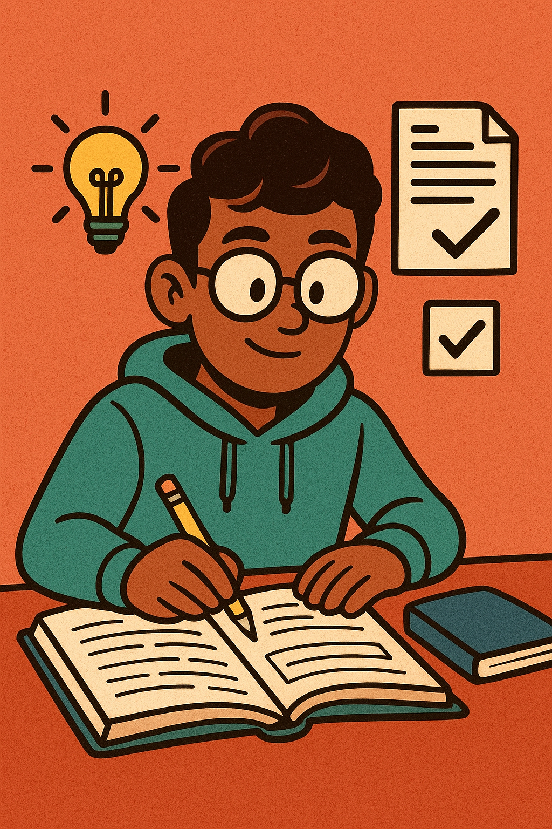
STUDY STRATEGIES
Recode info/make meaning
Practice tests/problems
Prepare a presentation
Study environment
Motivation/accountability
Notes:
All of these 1-4 promote retrieval and 5 promotes actually doing it.

Slide 7
RECODE INFO/MAKE MEANING
TITLE/TOPIC
Cues
Preparing and making meaning…
Gather all the information sources in one place
Create retrieval cues
Summarize 2-3 sentences by topic
Your
notes
Summary
Notes:
This was one of the questions – how to structure notes for studying…
This is also a great time to make meaning, make personal connections. “If you study like it matters, then it will.”

Slide 8
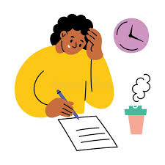
Practice tests/problems
Close notes/books
Test yourself in a similar way to the exam format
Use study guide or make one yourself/crowdsource
AI Tools: Notebook LM
Notes:
Check if there is more math specific advice

Slide 9
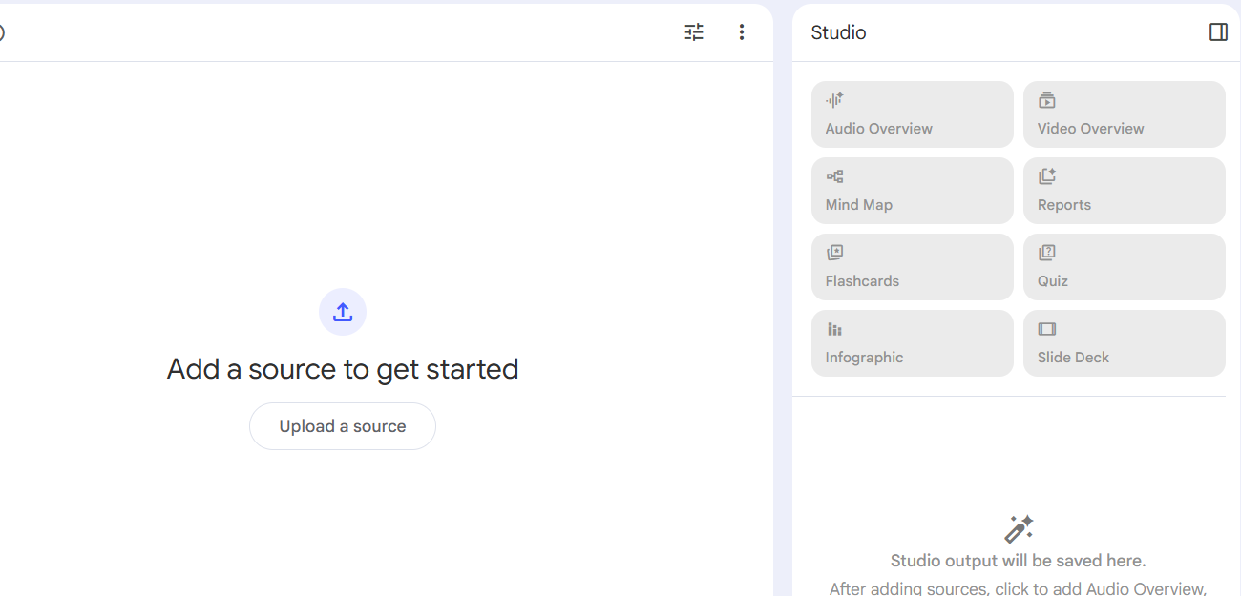

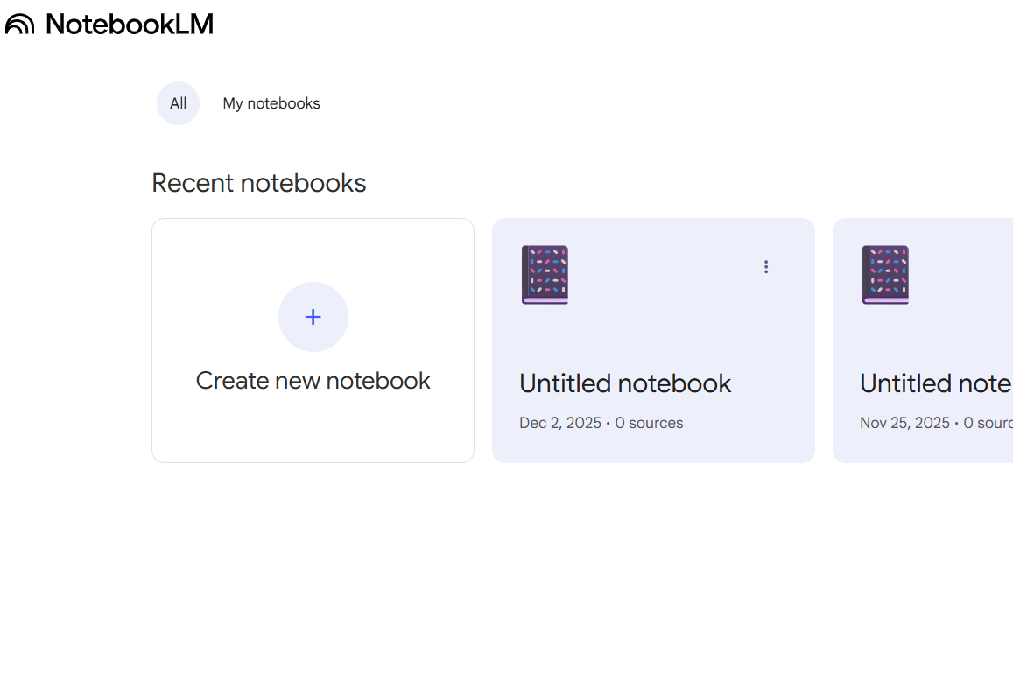
Google NOTEBOOK LM
>> Try Notebook LM
>> Create New Notebook
>> Explore tools!
Notes:
It’s FREEEEE
Anki resource

Slide 10

Prepare a presentation
Study like you are preparing a presentation
Deep learning posture
Use a few cues but rely mostly on your memory
Turn on video camera to present to yourself or a friend
See how much you recall on each topic

Slide 11
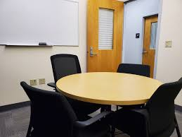
environment
Replicate exam-like conditions (especially when practicing retrieval)
Timer
Quiet
Study for different classes in different spaces
“Returning to the scene of the crime”
Sensory cues
Notes:
It’s important to know what “works for you” but you also have to be aware if what “works for you” is dramatically different than your typical exam setting. For example, café studying is great and energizing, but it is VERY different from a quiet classroom setting.

Slide 12
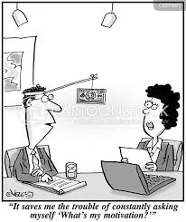
Motivation/accountability
Tell others your plan
Keep your phone FAR AWAY
Body doubling
Make appointments
Remember your why
Notes:
Body doubling is a productivity technique where a person works alongside someone else, either in person or virtually, to stay focused and accountable. It can be used for any task and is particularly helpful for people with ADHD, as the mere presence of another person can provide motivation, reduce distractions, and encourage task completion. The other person, or "body double," doesn't necessarily have to interact or work on the same task, but their presence helps create a more focused environment.
Put God here.

Slide 13

Exam day
Framing: this is a chance for me to show what I know
Interpret nerves positively – I am pumped and ready to go!
Write it out if you know there is anxiety there
Have your positive self-talk ready
Notes:
Moderate levels of stress can actually improve motivation, memory, and attention, and enhance test performance. Test anxiety, however, involves stress and worry that interferes with test performance, well-being and attitudes towards school. Symptoms: sweating, nausea, stomachache, shaking, muscle tension, nervousness, feeling like mind going blank.
ADD: our self-worth is not tied up in the exam but God.
Positive self-talk examples:
“I am well-prepared for this test.”
“I am going to do my best.”
“I can get through this.”
“This is going to be okay.”
“Tests are never as bad as I think they’ll be.”
“Even though I am anxious, I can still do well.”
“I’ll use relaxation skills to calm down.”
“I can see myself passing this test.”

Slide 14
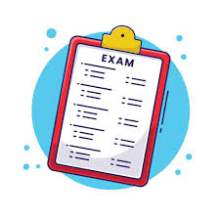
Test-taking strategies
Preview
Consider point values
Do a “memory dump” (like making a word bank)
Ensure you know what is actually being asked
Check your work like you’re checking someone else’s
Notes:
It’s the worst thing to get an exam back and think – why did I make that silly mistake! Anxiety can cause more mistakes.

Slide 15

RECAP
Key Questions
Studying Musts
Strategies that Work
Exam Day
Game plan

Slide 16

Game plan
What new strategy will you try while studying for finals?
What environments will you use for studying?
How are you going to address your common barriers to studying?
What schedule can you make that will include spaced repetition?
How can you hold yourself accountable?
Notes:
Mention peer coaches, make a schedule and stick to it! Any questions I didn’t answer?

Slide 17
Questions?
Learning & Accessibility Services
LAS Peer Coach
www.wheaton.edu/las
las@wheaton.edu

